Slide 1
Social Media: What Happens when someone passes away?
March 1, 2022

Slide 2
Overview
Introductions
John Anstey
Lance Morgan
Introducing Anstey Hodge

Slide 3
agency overview
Introducing Anstey Hodge:
17 Full-time Employees
Services
Full-Service Agency – From strategic planning to creative and digital services.
Coast-to-Coast Clients
Awards
150+ Awards Won
Agency founders hold Silver Medal Awards (lifetime achievement awards from AAF)
Google Partner Agency

Slide 4
overview
Social media is widely used among younger generations, and use is rapidly growing among older generations. With most people posting about their lives, it begs the question, what happens to their social media accounts when they pass away?
Once our loved ones pass away, we may be left with their social media pages up and still receiving messages.
Many social media platforms now have guidelines for how to take down your deceased loved one’s pages or put them in a memorialized state.

Slide 5
overview
We have put together a summary for each major social media platform, with information on how to remove your loved one’s pages and whether the platform has a virtual memorial option. Including:
Facebook
Instagram
LinkedIn
Pinterest
Snapchat
TikTok
Twitter

Slide 6
Facebook
Three Options with Facebook
Memorialize an Account after Death
Setting up a Legacy contact before Death
Remove an Account Completely

Slide 7
Facebook
Memorialize an Account
Facebook will memorialize an account, but a family member or close friend must inform Facebook of the death. No login information will be shared, meaning that no one can log in to the account after it becomes memorialized.
To show the profile’s status, a “remembering” badge will be added to the individual’s name. Content will stay visible, but the profile won’t appear in public places or pop up as a suggested friend.

Slide 8
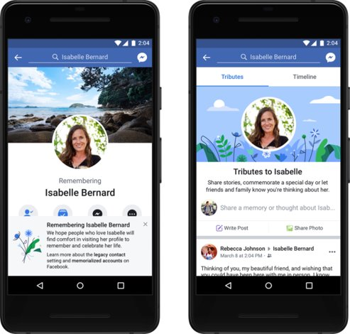

Slide 9
Facebook
Legacy Contact
As the owner of your own Facebook page, you may choose to designate a legacy contact who can accept friend requests, pin a tribute, and change the account’s profile picture and cover photo after your passing. Your legacy contact must be chosen prior to death, and you must be over 18 to choose a contact.

Slide 10
Facebook
Legacy Contact
To select a legacy contact, go to “Settings” under “Settings & Privacy” in your Facebook account. Then select “Memorialization Settings” and choose the friend you wish to be your legacy contact. The legacy contact you've selected will be informed, and if your account is memorialized, they will be notified.

Slide 11
Facebook
Remove Account Completely
You can have your loved one's account completely removed from Facebook.
Items you will need
Death Certificate
Copy of Obituary or Memorial Card
Proof of Authority, such as Power of Attorney, Last Will and Testament, etc.
For more information on Facebook’s policies, click here.

Slide 12
Facebook

Slide 13
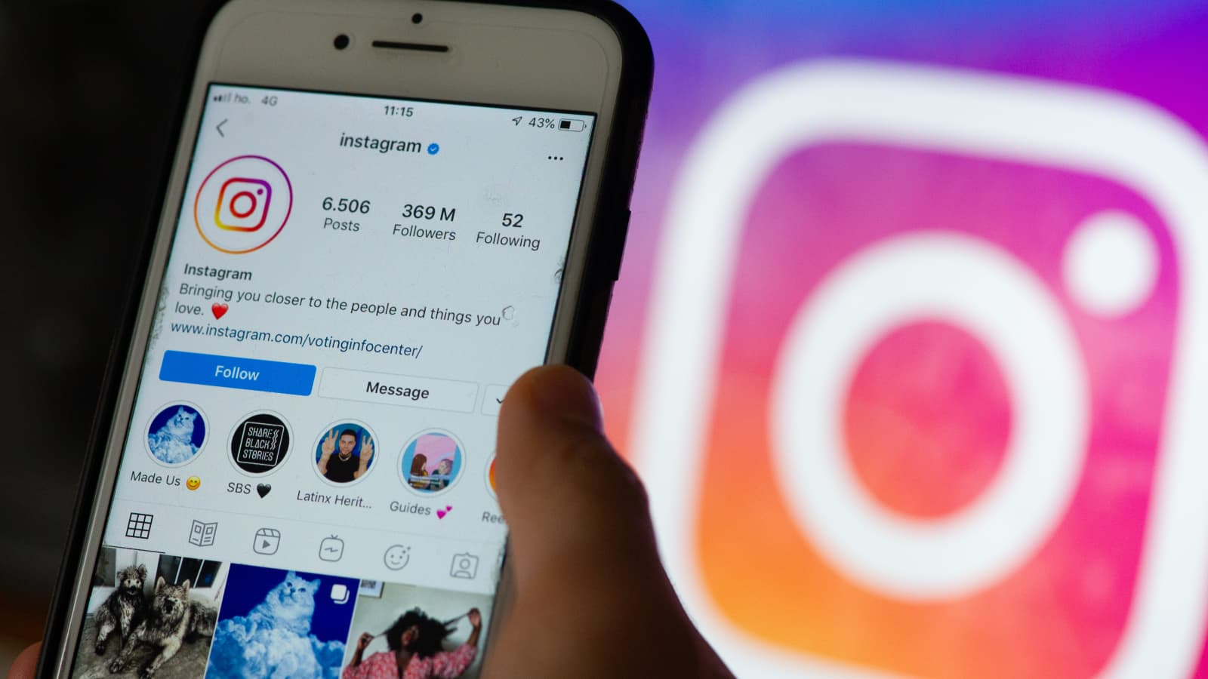
Instagram
Like its parent company, Facebook, Instagram offers a memorialization option. To memorialize someone’s account, you must provide Instagram with proof of death in the form of a link to an obituary or news article.
By memorializing the profile, it becomes frozen in time, with all photos, videos, and comments visible to the audience they were originally shared with. Privacy settings cannot be changed when an account is memorialized.

Slide 14
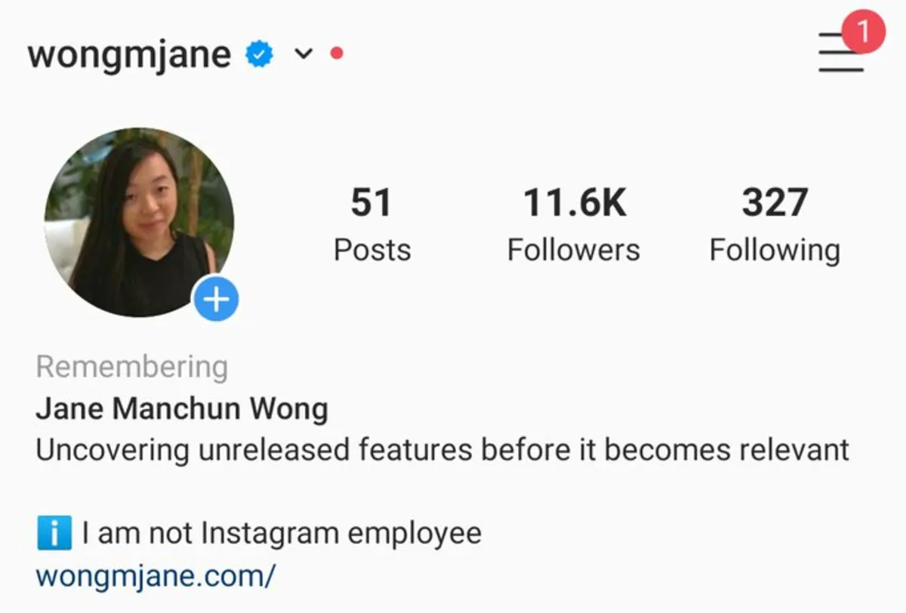
Instagram
The word “Remembering” will be shown next to the person’s name on their profile, and the account will no longer appear in Instagram’s Explore section. Instagram tries to “prevent references to memorialized accounts from appearing on Instagram in ways that may be upsetting to the person’s friends and family.”

Slide 15
Instagram
To delete the Instagram account of a deceased individual, official documentation is required from a verified immediate family member. When submitting a removal request to Instagram, be prepared to provide the deceased’s birth certificate, the deceased’s death certificate, or a power of attorney showing you are the executor of the deceased’s estate.
For more information on Instagram’s policies, click here.

Slide 16
linkedin
LinkedIn provides a form where individuals can report that a LinkedIn member is deceased, which then hides the account. It requires that you input the deceased’s name, the URL of their LinkedIn profile, your relationship to the deceased, the deceased’s email address (associated with their LinkedIn profile), the date of their passing, a link to their obituary, and any other information that may help make the case for closing the account.

Slide 17
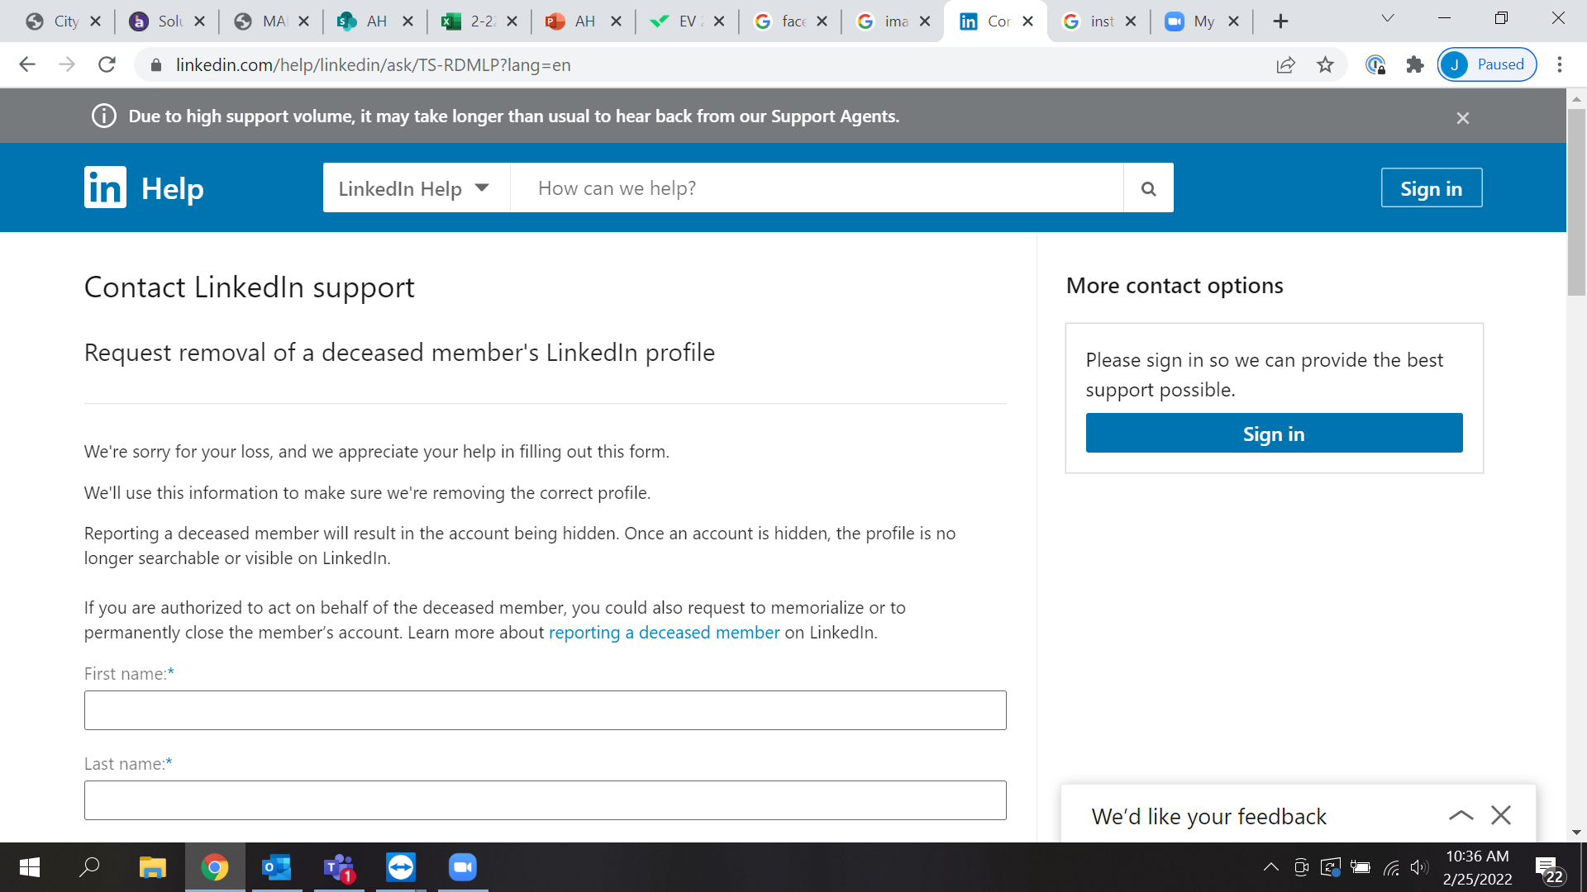

Slide 18
linkedin
To close or memorialize a LinkedIn account, you will need to submit a copy of the deceased’s death certificate and a legal document showing that you have the authority to act on the deceased’s estate (e.g., Letters of Administration, Letters of Testamentary, or Letters of Representation). Closed accounts are permanently removed from LinkedIn, while memorialized accounts are marked as such. No further login access will be granted to the account.
For more information on LinkedIn’s policies, click here.

Slide 19
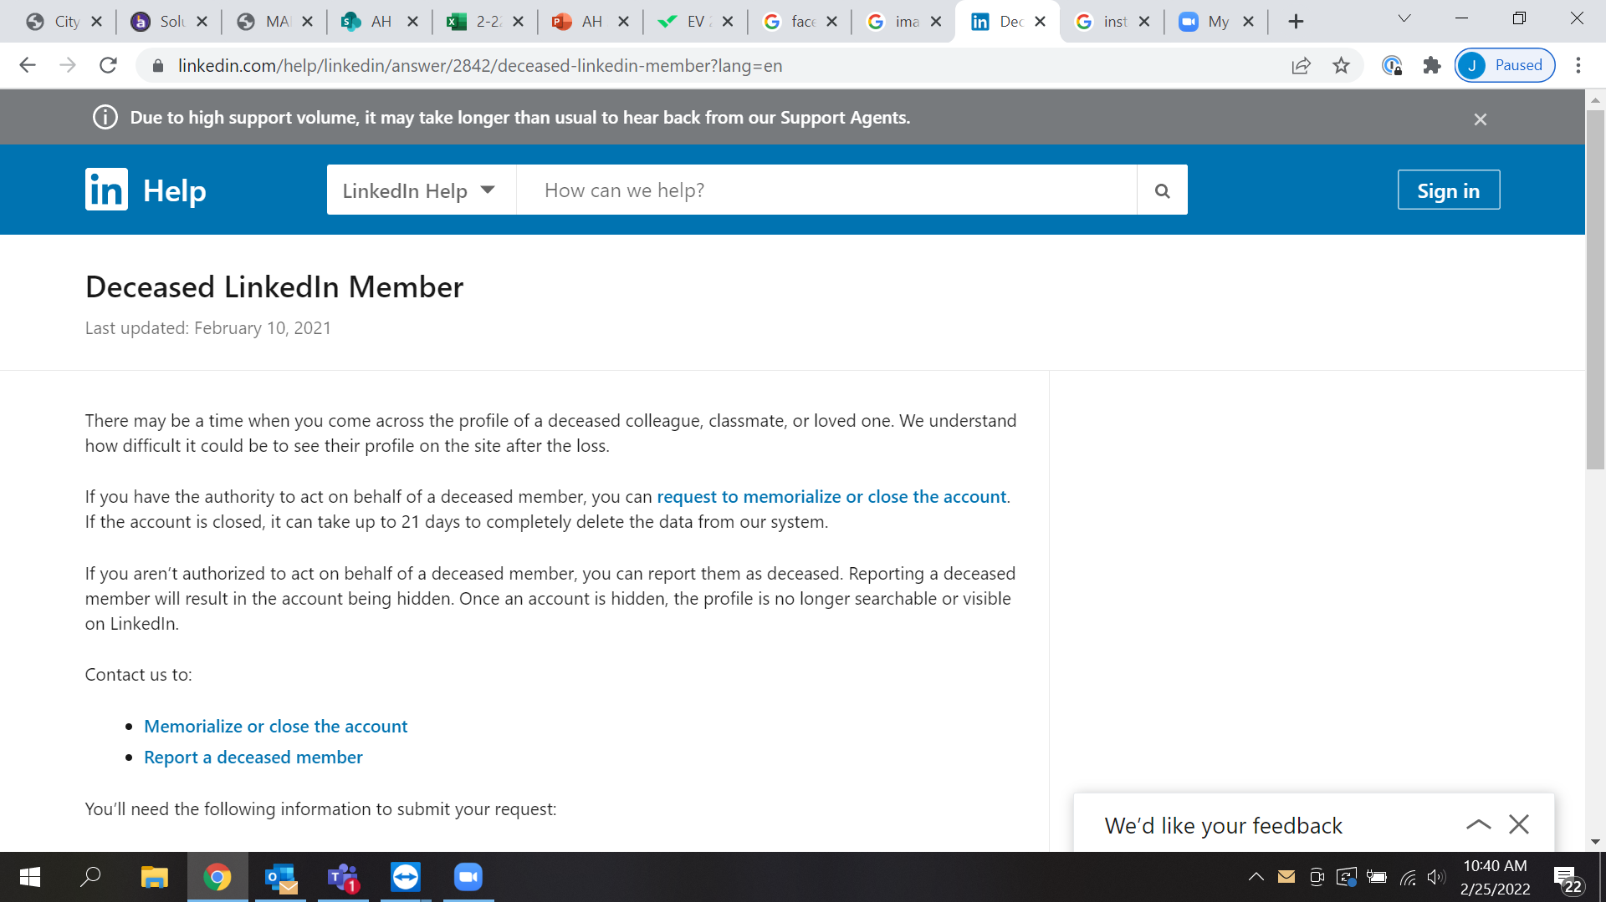

Slide 20
pinterest
To deactivate a deceased family member’s account, you will need to go through Pinterest’s help center. Additional documentation may be requested. Pinterest will not provide personal or login information for access to the deceased’s account.

Slide 21
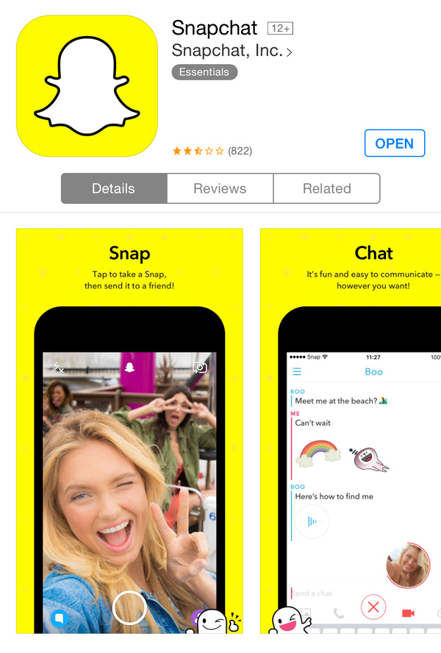
snapchat
Snapchat will delete the account of a deceased user if they are provided with a copy of the death certificate. Snapchat will not allow anyone access to a deceased user's account and does not have a memorialization option. Contact Snapchat to report a deceased user here.

Slide 22
tiktok
TikTok does not offer a memorial option for a deceased user’s account. If you would like to delete the account of someone who has passed away, contact TikTok here. Additional documentation may be requested. Once an account is deleted, it cannot be reactivated, and none of its content or information may be accessed.
For more information on TikTok’s policies, click here.

Slide 23
twitter
Twitter requires the deceased’s executor or a verified immediate family member to submit an account removal request with the name and username of the account holder. After submitting the request, Twitter will contact the requestor for more information, including a copy of their ID and a copy of the deceased’s death certificate. No access will be provided to the deceased’s account regardless of a person’s relationship to the deceased.
For more information on Twitter’s policies, click here.

Slide 24
Thank You
march 1, 2022

